Slide 1
‘Vira’ – a model Chatbot for Alaskan airlines to help customers with Covid19 related questions
May 5, 2020

Slide 2





The Team
BHARGAVI
KAVITHA
POOJA
PONMALAR
SOWMYA

Slide 3
Why and What’s this project about?
Motivation
Abstract
Functionality
Model Chatbot Vira has been developed with an intent to help Alaska airlines customers by answering Covid19 related questions.
Our chatbot Vira have been tested with randomly asked questions, at 84% accuracy ‘Vira’ is efficient.
Due to covid19 Pandemic, Alaskan Airlines discontinued their chat service because of high call volumes, and they don’t have a chatbot. Our chatbot Vira would be a perfect solution to address this problem.

Slide 4

Dataset
Our dataset is textual with raw
data taken from Alaska airlines

Slide 5
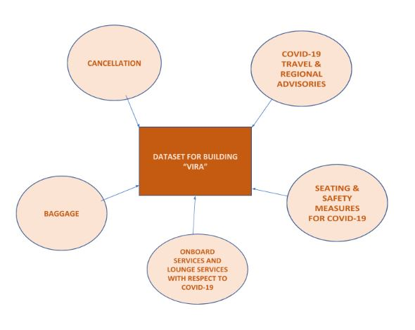
Dataset Preprocessing
- Word and sentence tokenization
- Removed ASCII values
- Removed tags of any kind
- Conversion to lowercase
- Lemmatization

Slide 6
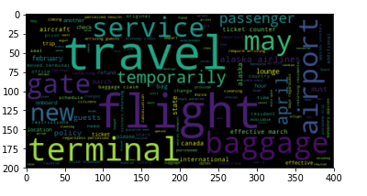
Summary Statistics
- Word Cloud
- Lexical Dispersion Plots
- Accuracy is 84% calculated manually
- Bar plots to show distribution of topics
and average length of questions
Word cloud to highlight important words in dataset

Slide 7
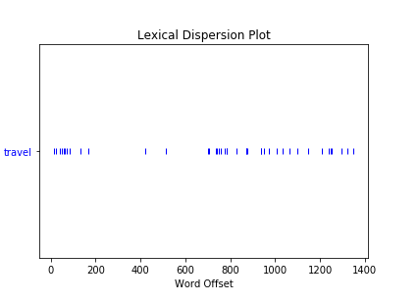
Summary Statistics
Lexical dispersion chart for word ‘Travel’

Slide 8
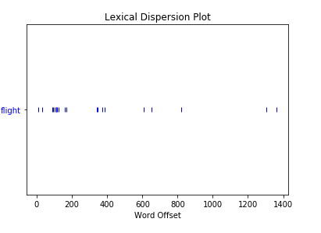
Summary Statistics
Lexical dispersion plot for word ‘Flight’

Slide 9
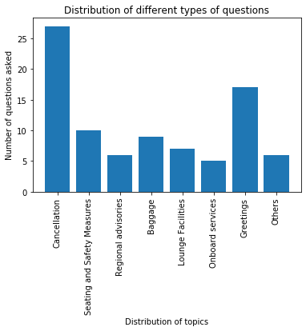
Summary Statistics
Bar plot to show distribution of topics

Slide 10
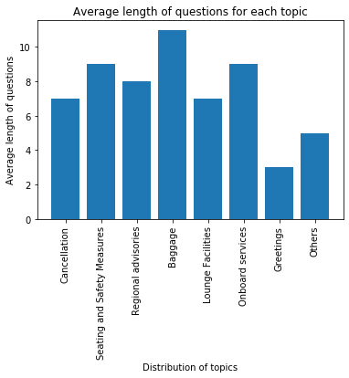
Summary Statistics
Bar plot to show average length of questions in each topic

Slide 11

Methodologies
- Natural Language Toolkit (NLTK)
- TF-IDF
- Tkinter library
- Cosine Similarity

Slide 12
Step by step process of our chatbot building
Imported required libraries and packages
Response function was defined using TF-IDF and Cosine Similarity
Execution and Testing
STEP 3
STEP 1
STEP 2
STEP 3
STEP 4
STEP 5
STEP 4
STEP 2
STEP 5
STEP 1
Created textual dataset and pre-processed
Graphical user interface was built using Tkinter library

Slide 13
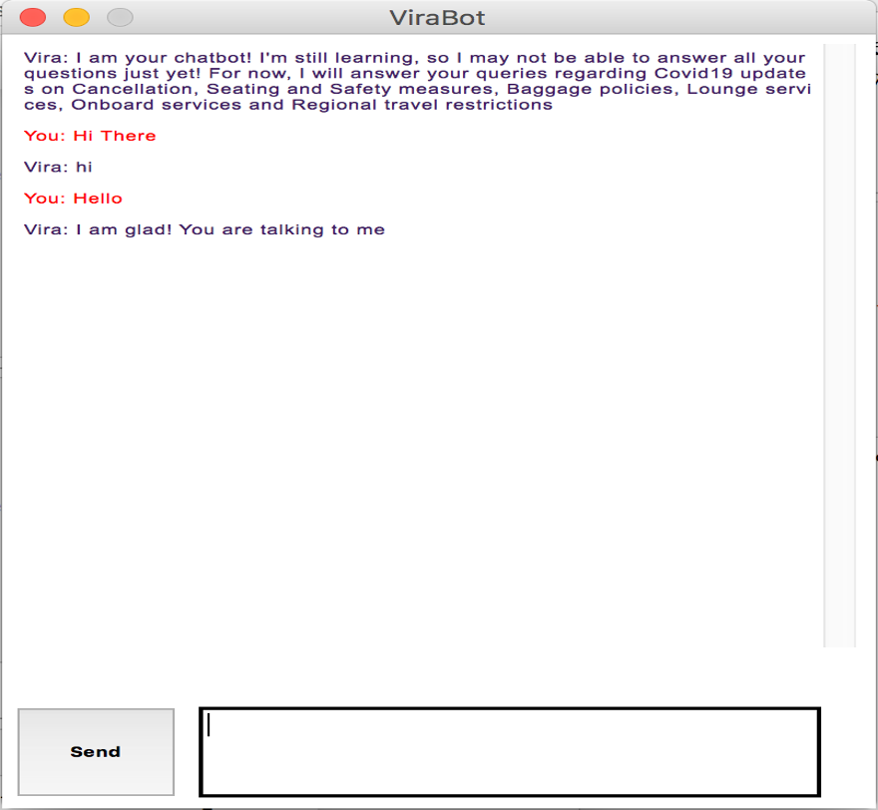
Analysis and Results
Snapshot of Vira’s GUI chat window popping out successfully once we executed the code

Slide 14
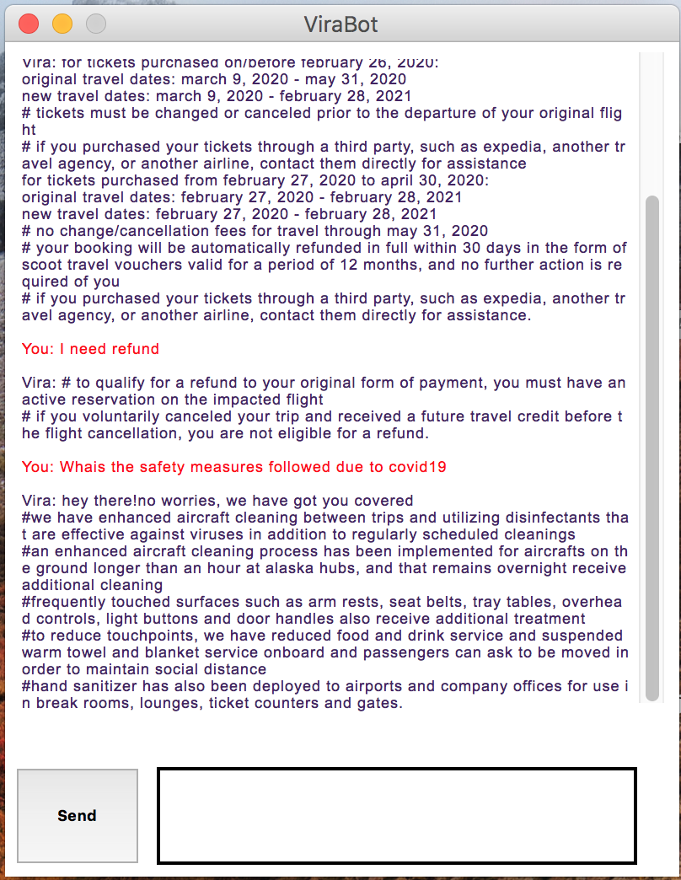
Analysis and Results
Snapshot of Vira answering efficiently to questions related to Refund and Covid19 Safety measures

Slide 15
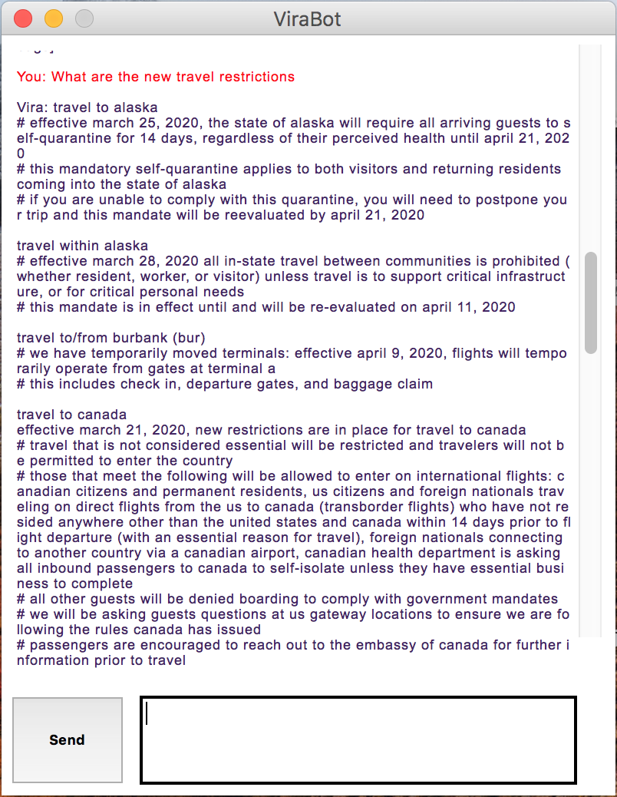
Analysis and Results
Snapshot of Vira answering to Travel related question

Slide 16
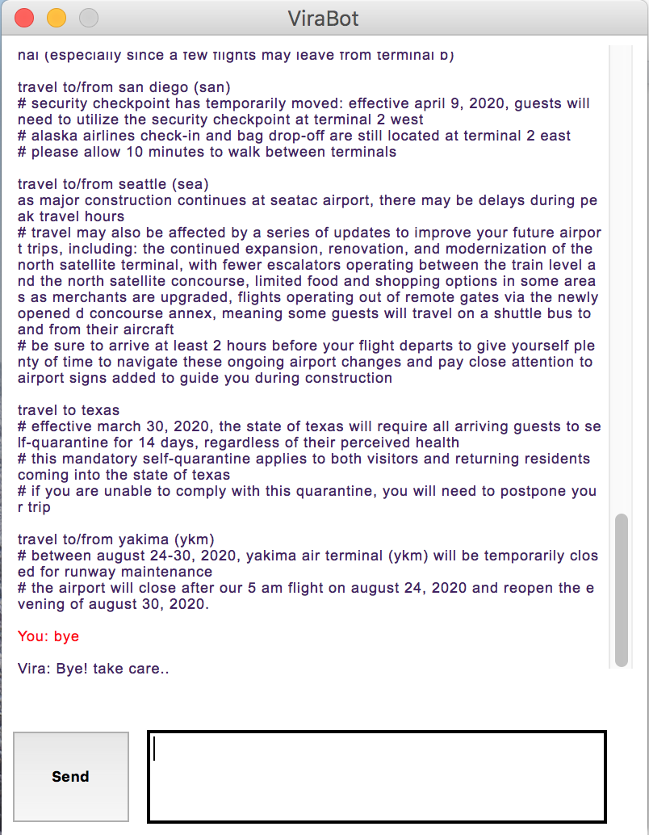
Analysis and Results
Snapshot of Vira ending the conversation when user typed bye

Slide 17
Closing thoughts
- Our chatbot ‘Vira’ is efficient with 84% accuracy
- Potential chatbot model for Alaska Airlines digital customer service mix
- Cost, Time and Resources efficient

